Slide 1
INTRODUCTION TO INNOVATION, IP MANAGEMENT & ENTREPRENEURSHIP MGT-207
Dr. SHOBHANA.N
Faculty,
School of Management,
SASTRA Deemed to be University,
shobhana@mba.sastra.edu

Slide 2
UNIT - IV
Intellectual Property Rights:
🠶 Introduction and the economics behind development of IPR: Business Perspective
🠶 - IPR in India – Genesis and Development
🠶 - International Context - Use of IPR to protect Innovation
🠶 - Concept of IP Management,
🠶 Use in marketing Patent- Procedure, Licensing and Assignment,
Infringement and Penalty –
🠶 Trademark- Use in marketing, example of trademarks- Domain name –
🠶 Geographical Indications- What is GI, Why protect them? –
🠶 Copyright- What is copyright –
🠶 Industrial Designs- What is design? How to protect?
🠶 Class Discussion- Major Court battles regarding violation of patents between corporate companies

Slide 3
Intellectual property rights
🠶 The World Intellectual Property Organization (WIPO)
defines
Intellectual property (IP) as “creations of the mind:
inventions,
literary and artistic works, and symbols, names, images, and designs used in commerce.”
More specifically, intellectual property refers to a broad collection of rights relating to such matters as works of authorship, which are protected under copyright law;
--inventions, which are protected under patent law;
---marks, which are protected by trademark law;
-- as well as trade secrets, designs and other related rights.

Slide 4
Intellectual property rights

Slide 5
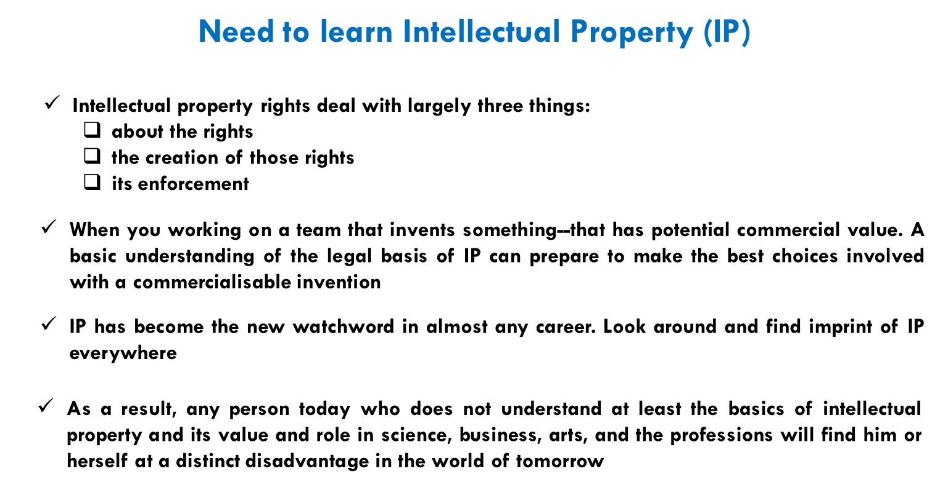

Slide 6
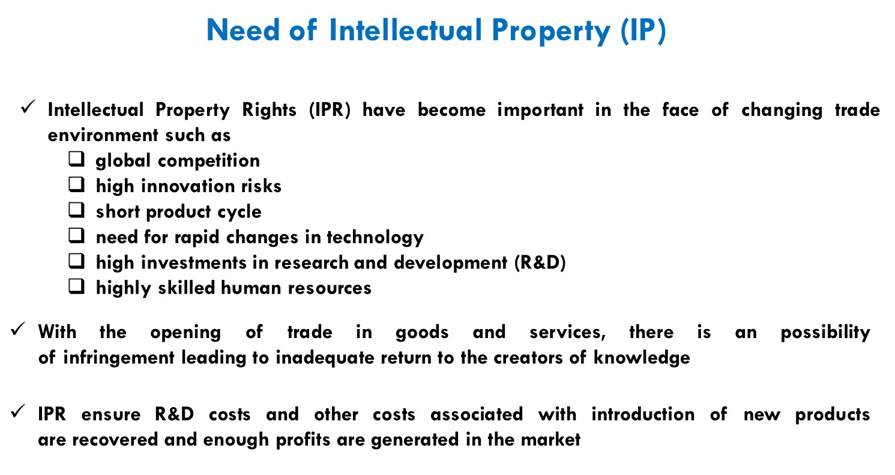

Slide 7
Need for IP-- History
🠶 The needs for copyright and related laws have become more and more evident especially through the opening up of the Information Society. Music and software are examples on this.
🠶 The intellectual property rights have changed over time but the main objectives have always been the same to encourage the inventing of new products and services to the benefit of the end-users.
🠶 The word copyright is mainly used to protect the rights of writings or production
by an author but nowadays also includes the software development.
🠶 Copyright only protects the “expression” from the author and not the idea behind it.
🠶 More and more products even in the mechanical industry nowadays have software included directly to the product or in the production of it which might be interesting for the company to protect.

Slide 8
Need for IP-- History
🠶 Intellectual property rights (IPRs) give the owners of ideas, inventions, and creative
expression the right to exclude others from access to or use of their property for a
certain period of time.
🠶 International treaties and the laws of the various countries differ significantly in terms of the degree of protection and enforcement available.
🠶 The need for intellectual property rights and related laws is to protect innovative products and services and also to secure companies and persons on the investment they have made to be able to marketing and distributing them to end users not to be copied by others.
🠶 The intellectual property rights are becoming increasingly important as they often cover huge economical values.

Slide 9
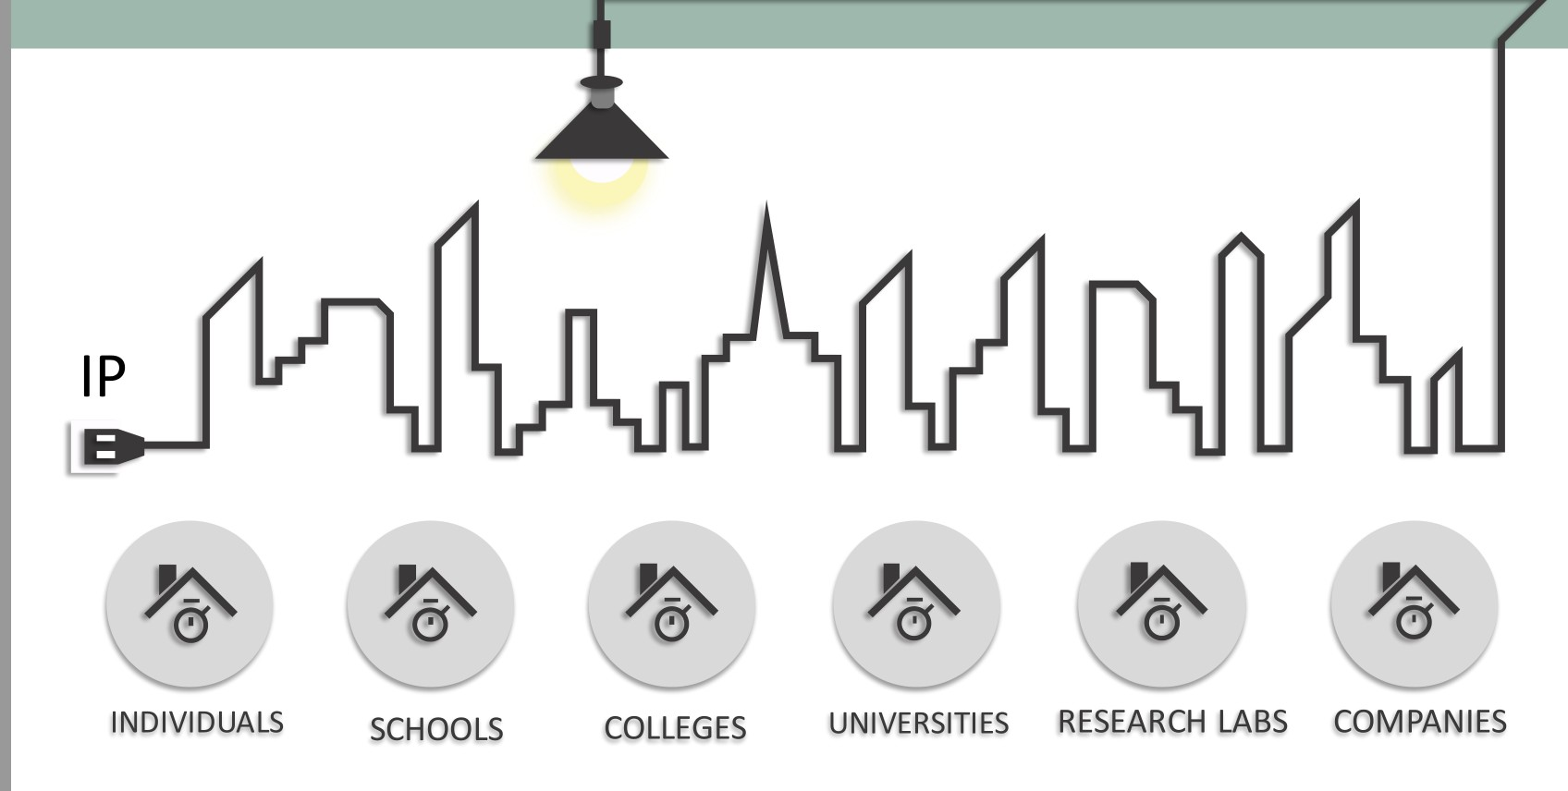

Slide 10
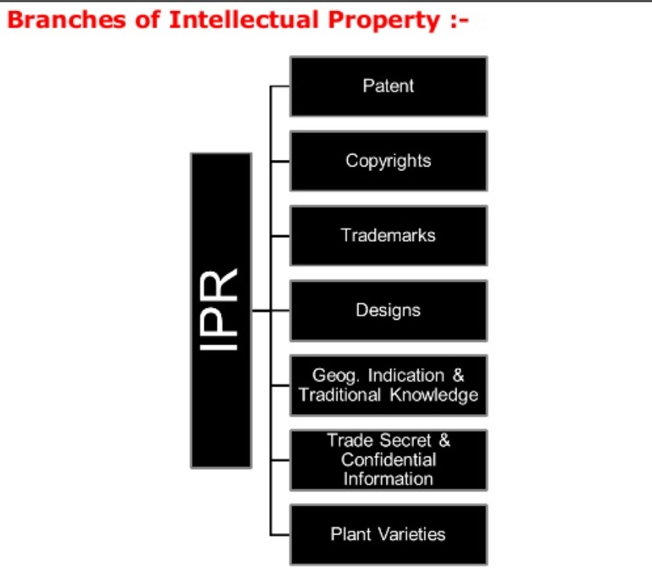

Slide 11
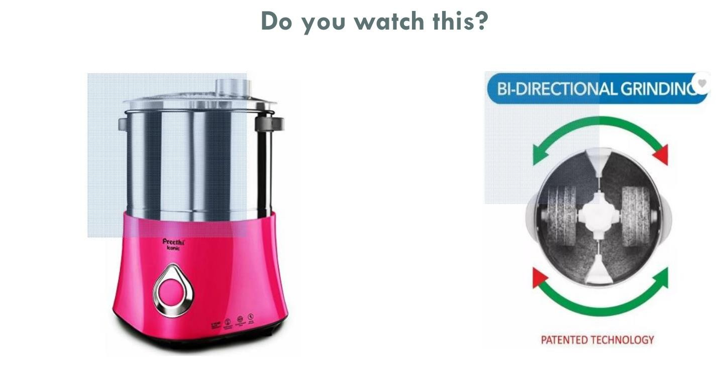

Slide 12
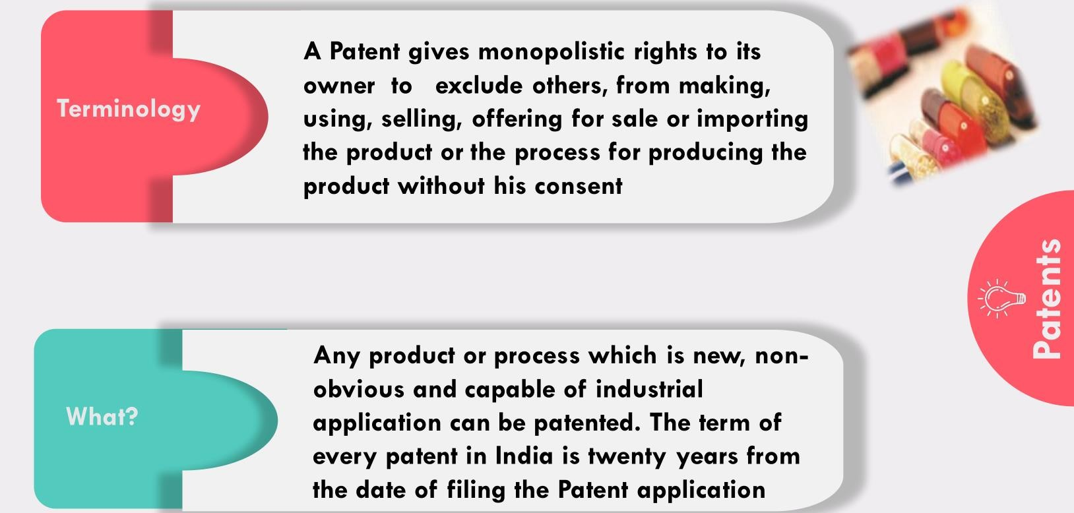

Slide 13
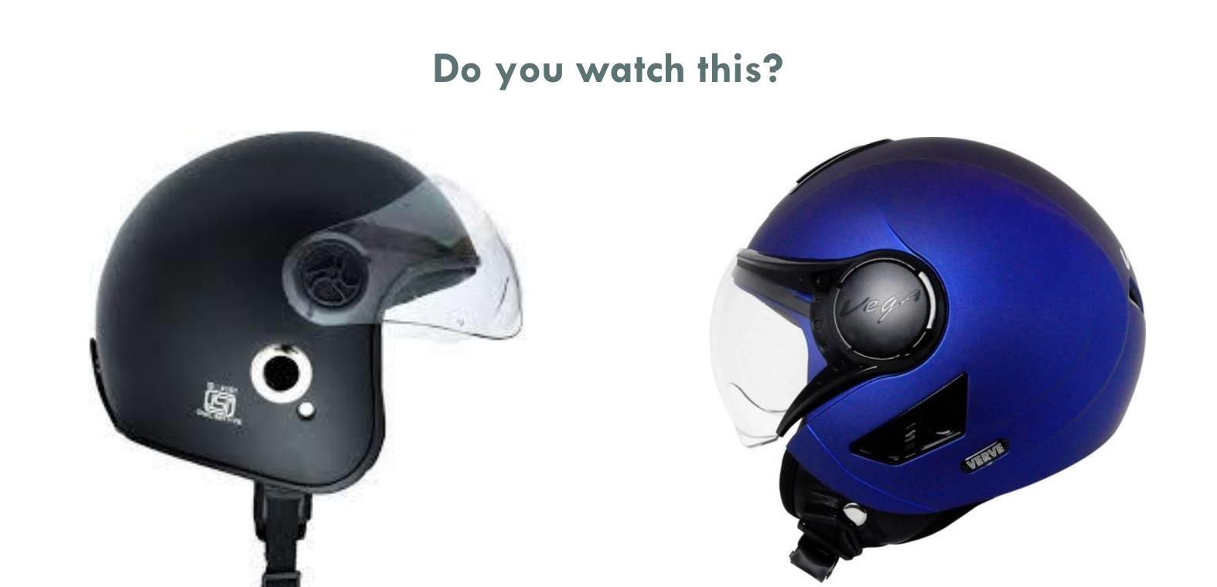

Slide 14
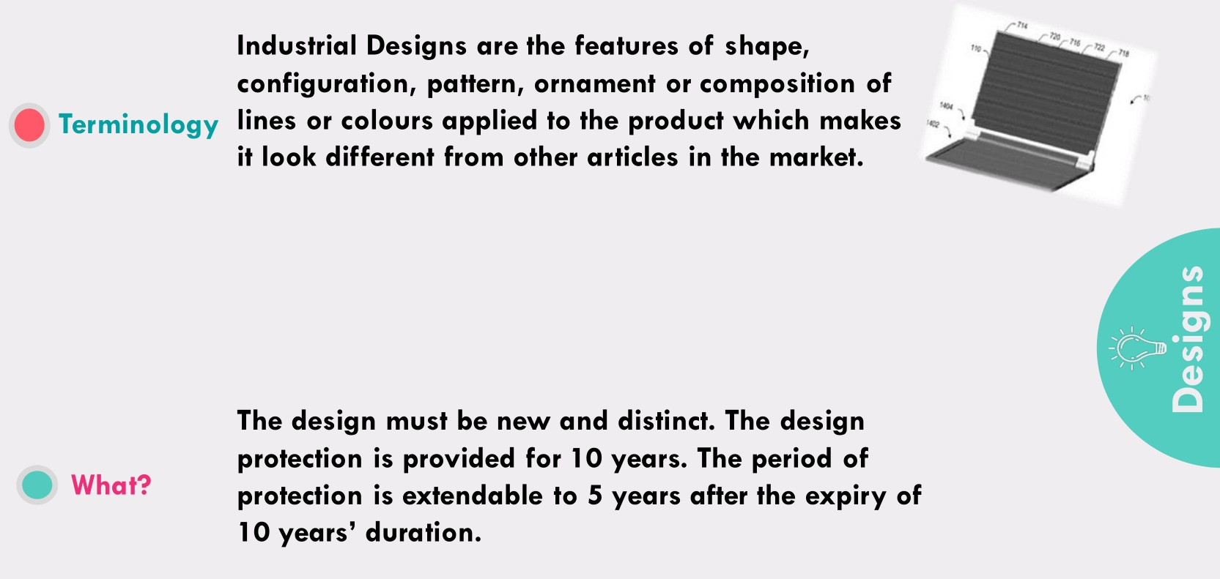

Slide 15


Slide 16
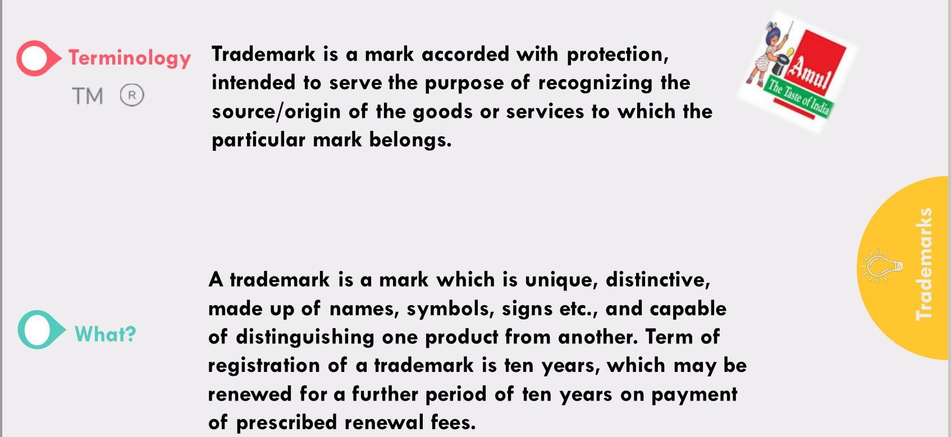

Slide 17


Slide 18
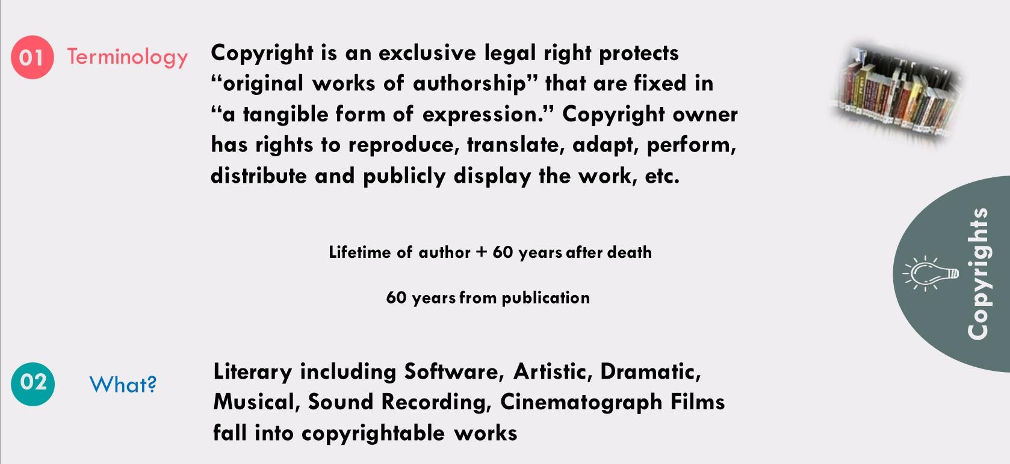

Slide 19
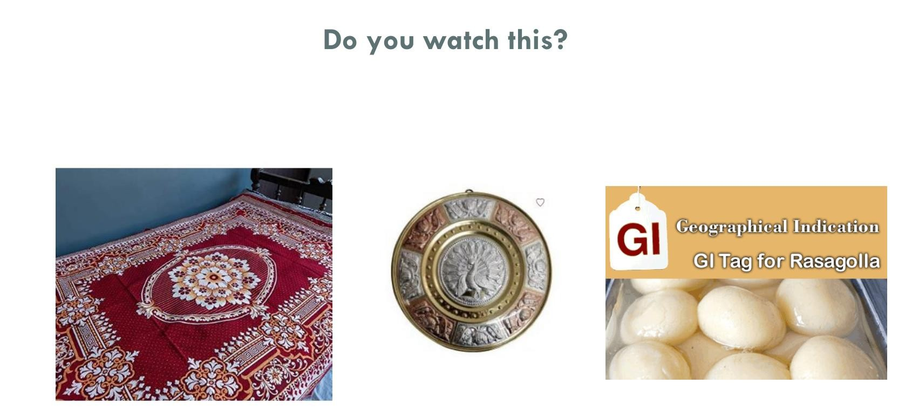

Slide 20
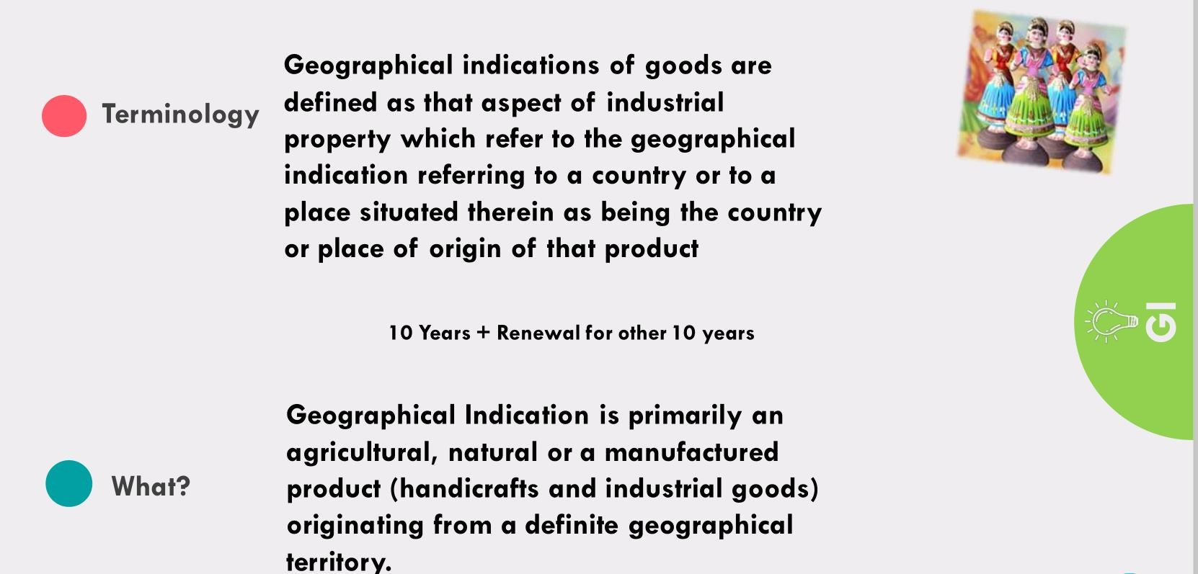

Slide 21
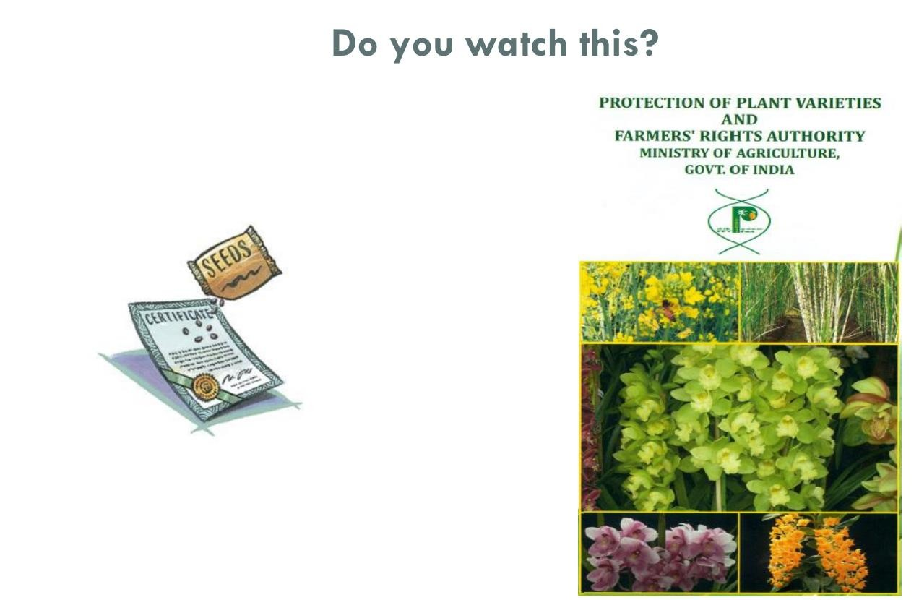

Slide 22
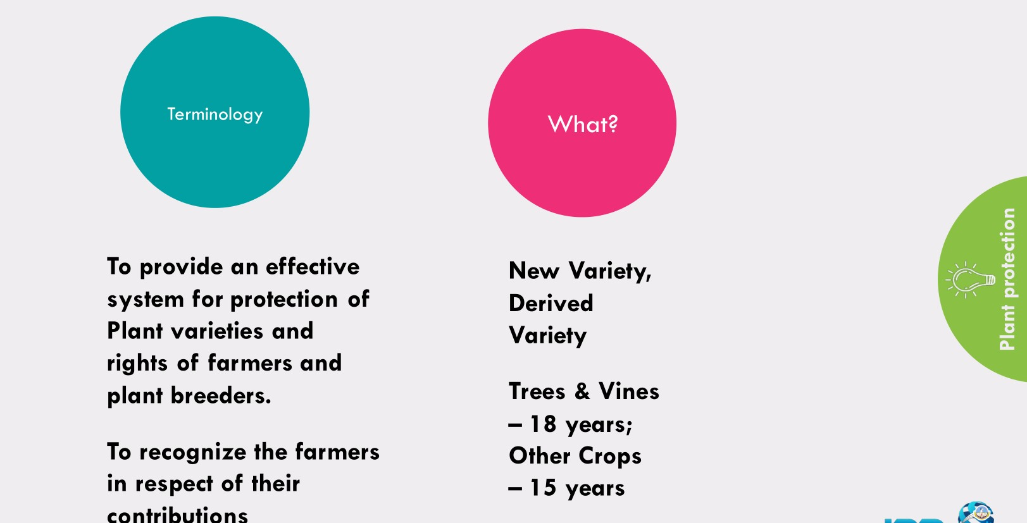

Slide 23
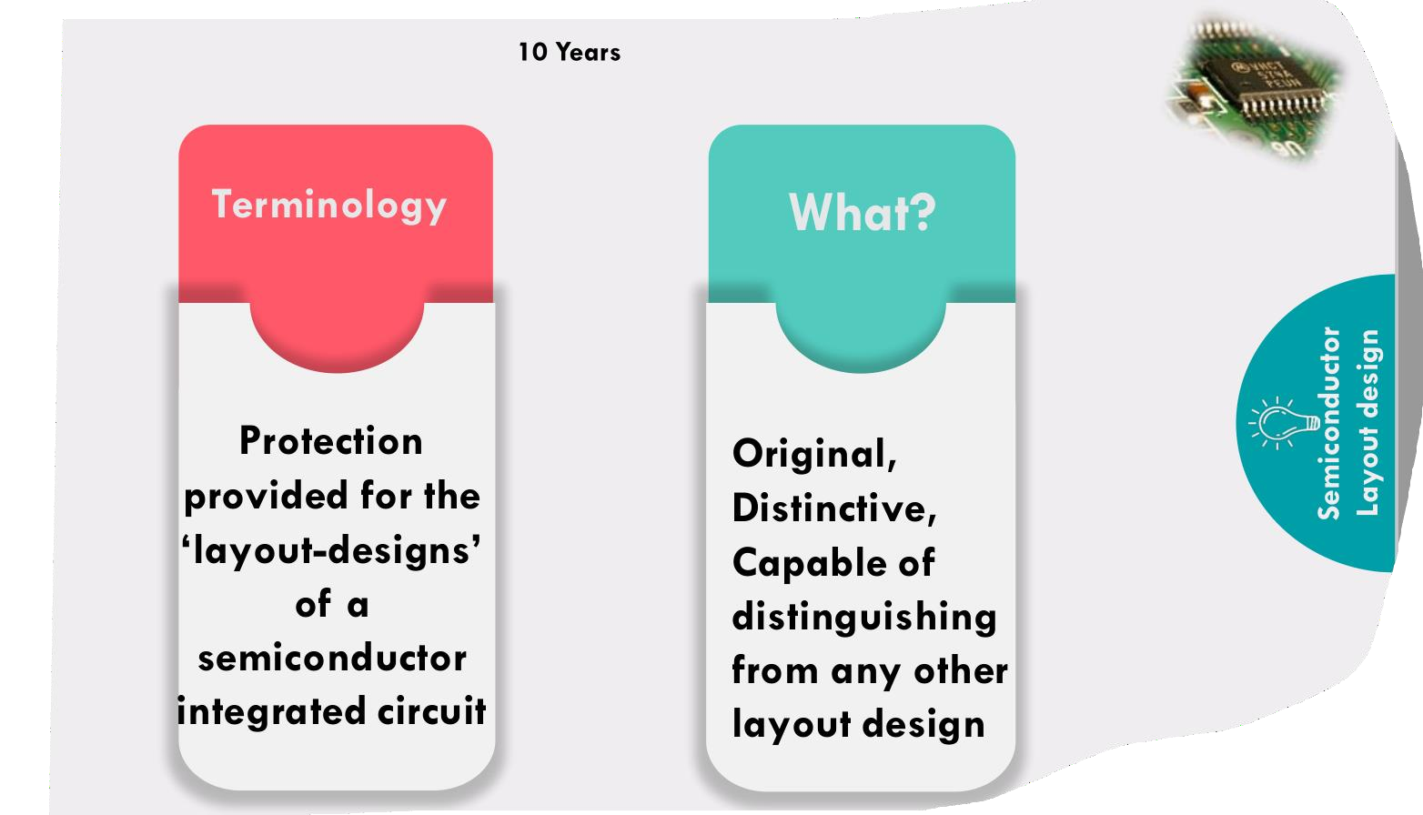

Slide 24
Patent
🠶 A patent is an exclusive right granted for a product or a process that provides a new way of doing something or offers a new technical solution to a problem.
🠶 A patent is regarded as a property right which can be issued nationally and/or in other countries where the company wants to protect its solution.
🠶 The patent gives the company exclusive right to manufacture, to use and to sell the product within a limited time period (20 years; can vary from country to country).
🠶 As it is a property it could be sold or licensed to others or be subject to contracts and/or other agreements.
🠶 Once a patent is issued it is possible to make profit on it especially for the
person(s) who is the inventor.
🠶 The patent can not be global so it must be protected in the countries where you want to market and to sell the product.
🠶 If there are many countries where the patent is needed, it might be a costly and administrative procedure.
🠶 International Patent Application (PCT Application) exists, but it is more a matter of an application system which will not give a global patent but a number of national patents.

Slide 25
Preconditions for patenting
🠶It is not possible to reward a patent to every invention.
🠶An invention must, in general, fulfil the following conditions to be protected by a patent.
🠶 -------------practical use; it must show an element of novelty, that is, some new characteristic which is not known in the body of existing knowledge in its technical field.
🠶This body of existing knowledge, called "prior art", could be checked using e.g. patent databases or general and technology-specific search engines.
🠶The invention must show an inventive step which could not be deduced by a person with average knowledge of the technical field.

Slide 26
🠶 Finally, its subject matter must be accepted as "patentable" under law.
🠶 In many countries, scientific theories, mathematical methods, plant or animal varieties, discoveries of natural substances, commercial methods, or methods for medical treatment (as opposed to medical products) are generally not patentable (WIPO, 2006).
🠶 The term “patent” ----- exclusive right granted to anyone who invents any new, useful, and non-obvious process, machine, article of manufacture, or composition of matter, or any new and useful improvement thereof, and claims that right in a formal patent application.
🠶 The patent is a government license that gives the holder exclusive rights to
a process, design or new invention for a designated period of time.
🠶 Applications for patents are usually handled by a government agency.

Slide 27
2. Applying for a patent
🠶 A normal patent application could in Europe be done in three possible ways:
National patent application which can be rewarded by the national organization
International patent application (according to the international patent application- PCT- system) which are sent to international organizations that have been given the right to handle these applications. At the end the national organizations in the country/ countries involved will be given the final reward.
European patent application, where the European organization for patents, European Patent Office-EPO, could reward a patent. The procedures are costly and take long time, often some years, and less than one year is very rare.
🠶 Consulting organizations ------main actors on behalf of the company or individual ---patent.
🠶 The more countries you want your patent rewarded in, the more costs you will have for consulting, translation and different fees.

Slide 28
Patent protection abroad
🠶 Protect a product also internationally even if coming back to national patent protection.
always
🠶 The international
patent protection PCT) or the European
(Patent patent
Cooperation Treaty –
protection (European Patent Convention – EPC) represent an opportunity for an international protection.
PCT application
🠶 The Patent Cooperation Treaty (PCT) is an international patent law treaty, concluded in 1970. It provides a unified procedure for filing patent applications to protect inventions in each of its contracting states.
🠶 A patent application filed under the PCT is called an international application, or PCT application. PCT is based on agreements between more than 100 countries.

Slide 29
Patent protection abroad
🠶 The main idea ----- application could partly ----single application ----- define the countries where the patent should be issued.
🠶 The application -------- the national patent registration office or, which often is the case, through the World Intellectual Property Organization (WIPO – www.wipo.int) in Geneva or the European Patent Office (EPO – www.epo.org).
🠶 The PCT application process ------international search -----
---------applicant a possibility to see what option there is to receive a patent.
🠶 After that an examination -------------expert -------------opinion of the possibility to receive the patent.
🠶 The international phase --------------followed by national phases in the countries where the patent is sought.

Slide 30
Application for European Patent – EPC
🠶 The European patent is based on the European Patent Convention, EPC, which came into force in 1977.
🠶 So far 36 states have become parties to the Convention and four states have made a separate agreement (the so-called extension states) to the effect that the European patents are extended to cover them too
🠶 According to a European agreement it is possible to receive a patent covering 40 European member states of European Patent Convention as well as some other countries by filing a single application for a European patent.
🠶 The application must include a list of countries where it should be
designated and if being approved it will be validated in those countries.
🠶 It is done through a translated version of the patent to all national
offices. The European Patent will result in national patents in designated countries.

Slide 31
Application for European Patent – EPC
🠶 The application could be sent directly to the European Patent Offices in English, German or French languages.
🠶 Application forms are available from the European Patent Office.
🠶 As in the PCT-application the process starts with a search to find out
any obstacles to the patent.
🠶 If the applicant wants to continue, then the assessment of the application will be done.
🠶 When it is ready for approval translation is needed in the three
languages; English, French and German.
🠶 It will also be published in the European Patent Bulletin.
🠶 The European Patent is actually not a true European patent but a number of national patents.
🠶 For that reason it still has to be validated in all countries which also will
include translation to national languages.

Slide 32
Trademark
🠶A trademark, trade mark, or
distinctive sign or indicator, used business organization, or other
trade-mark ----
by an individual, legal entity, to
identify that the products or services with which the
trademark appears originate from a unique source, and to distinguish its products or services from those of other entities.

Slide 33
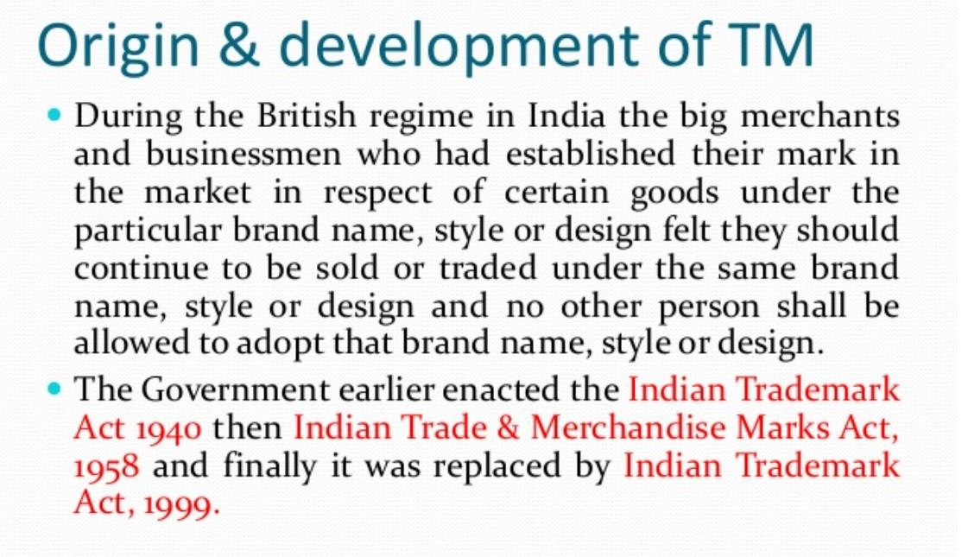

Slide 34
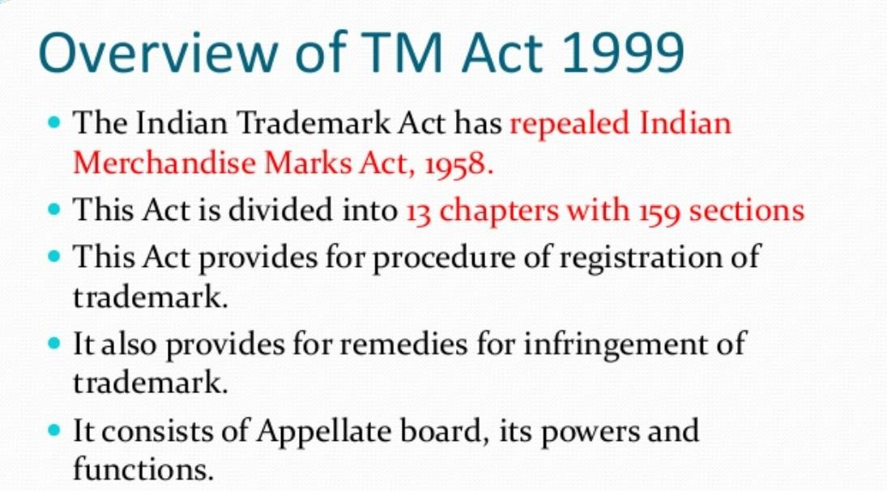

Slide 35
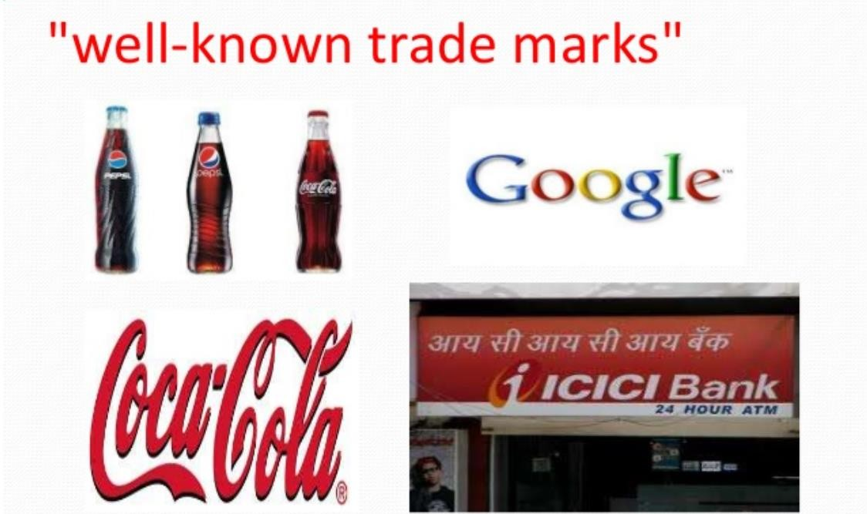

Slide 36
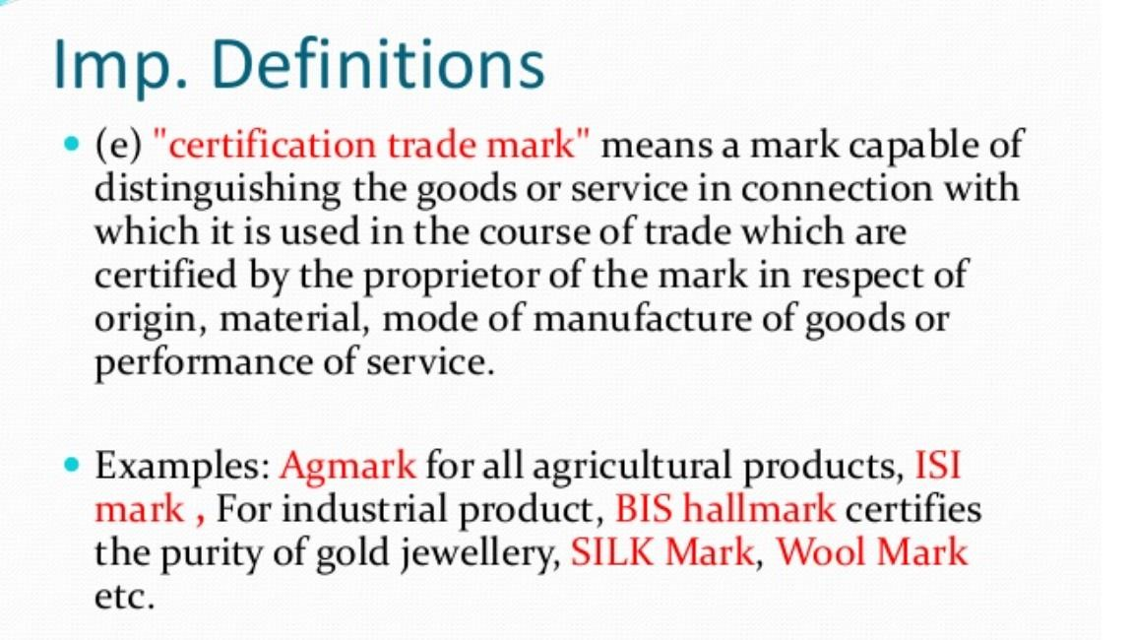

Slide 37
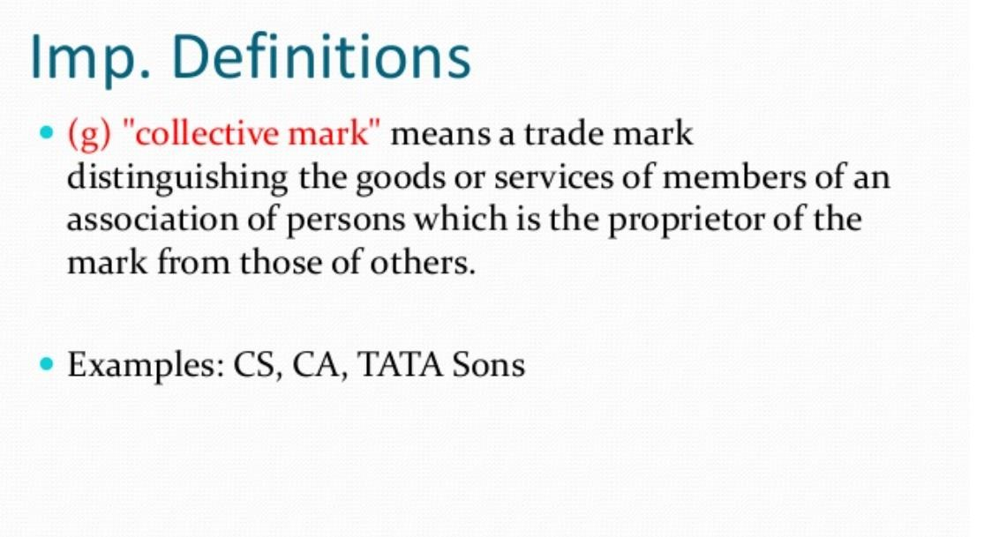

Slide 38
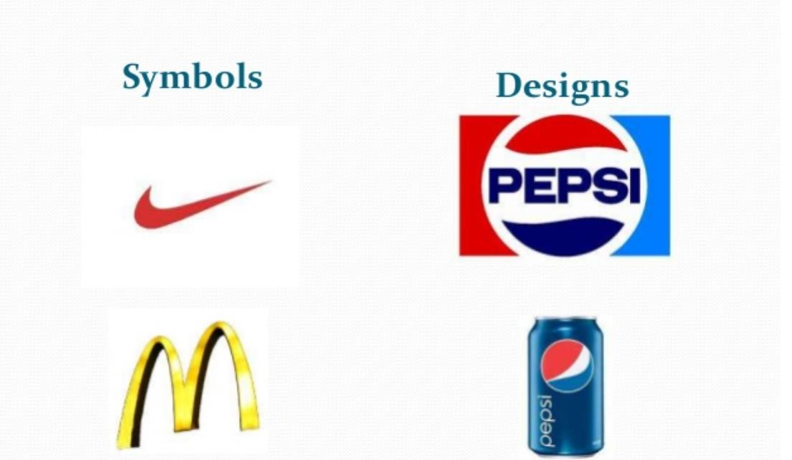

Slide 39
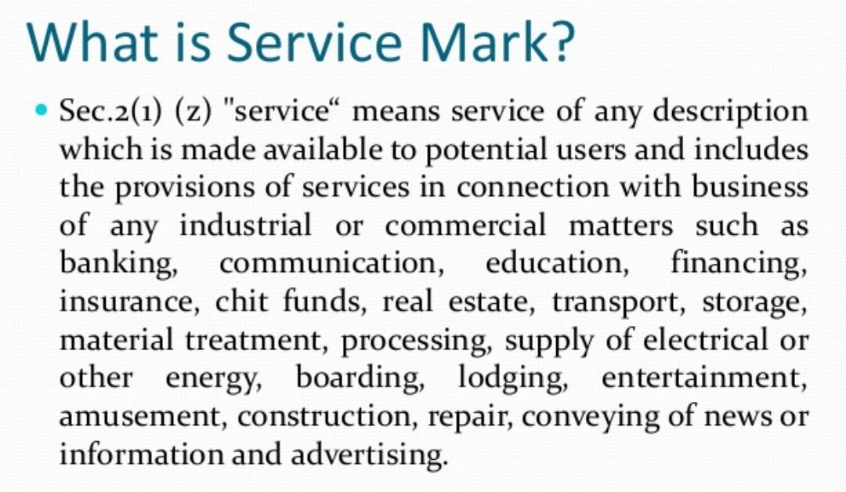

Slide 40


Slide 41
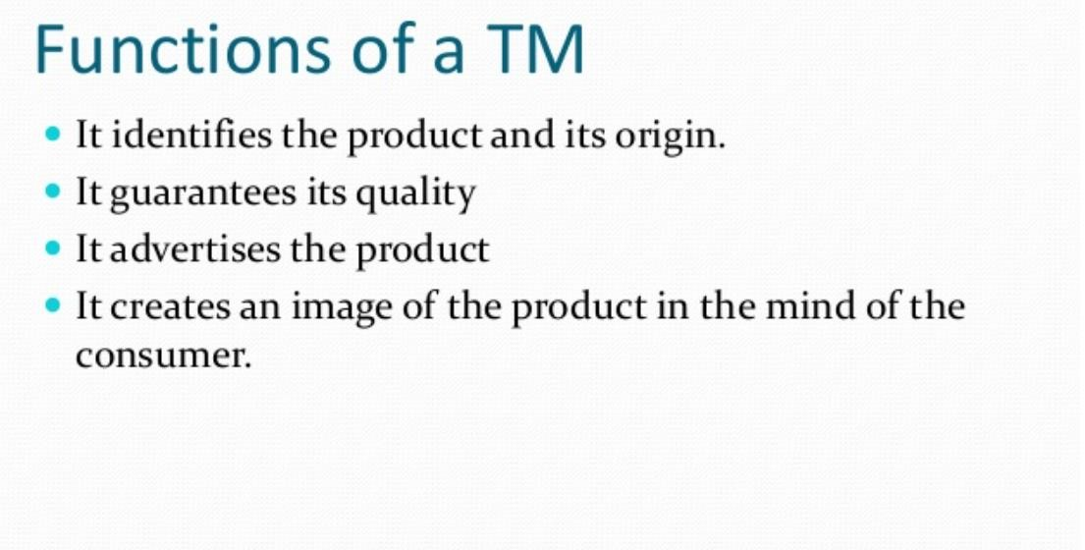

Slide 42
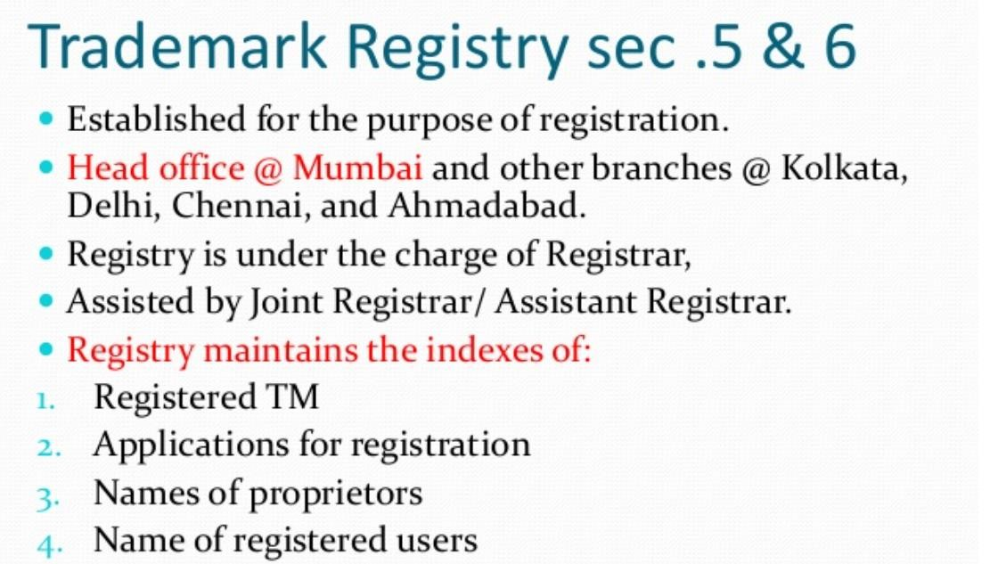

Slide 43
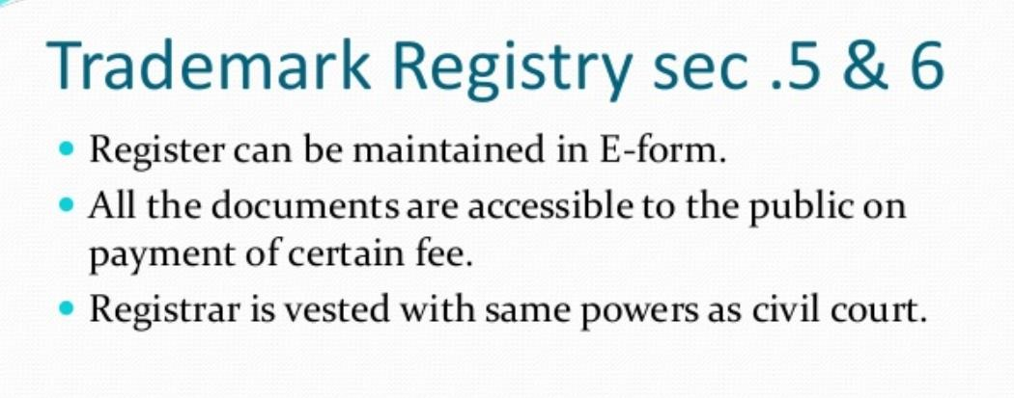

Slide 44
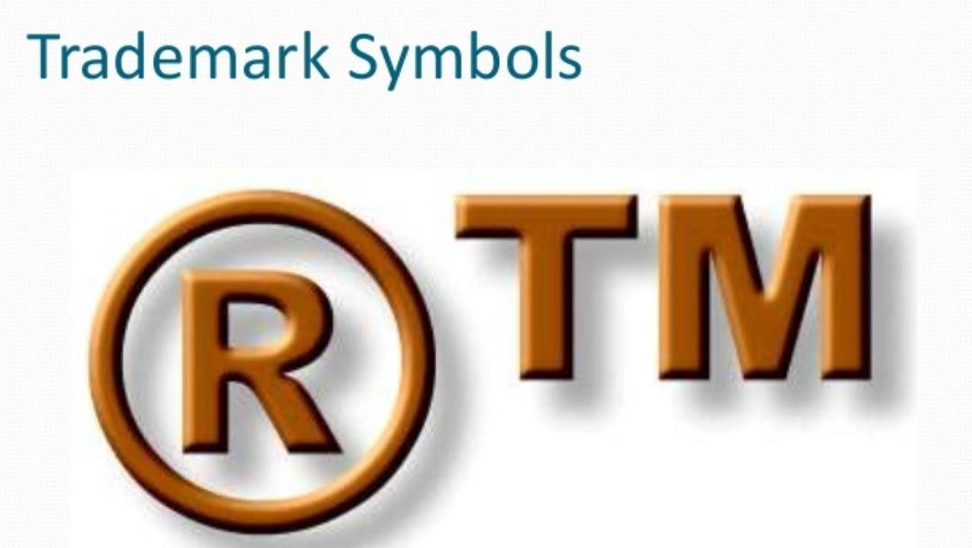

Slide 45
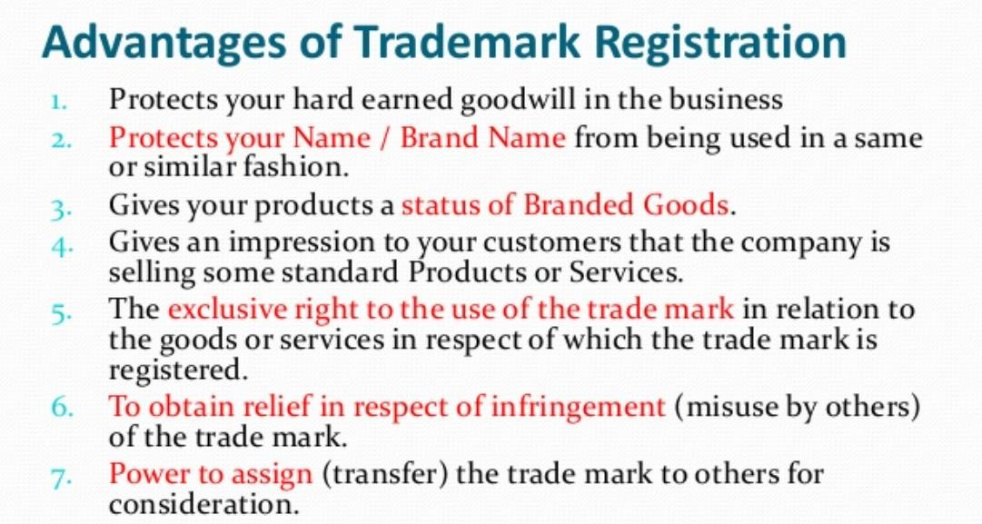

Slide 46
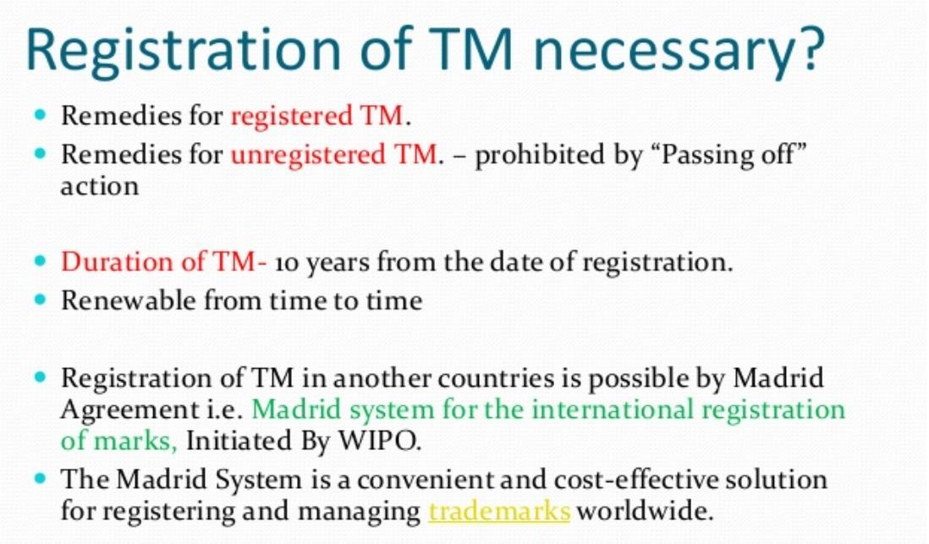

Slide 47
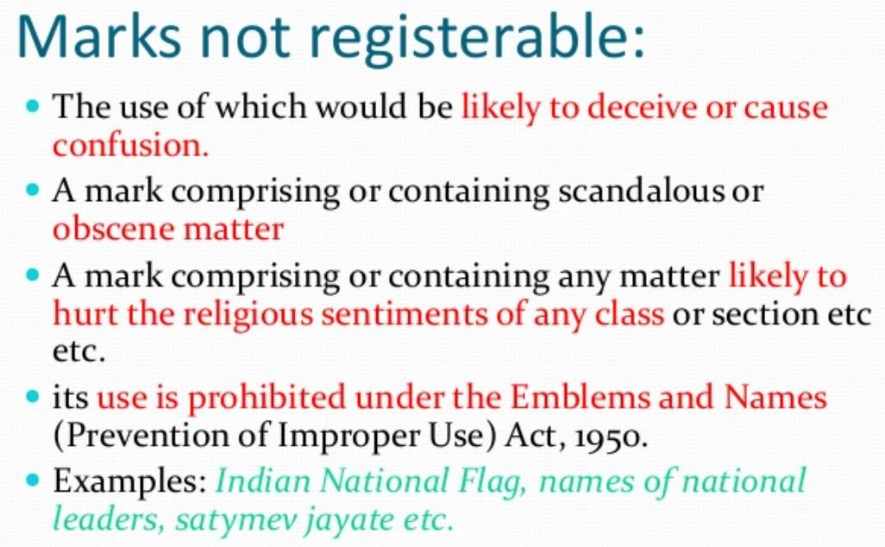

Slide 48
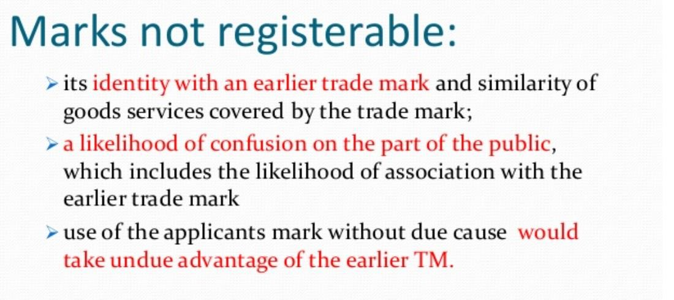

Slide 49
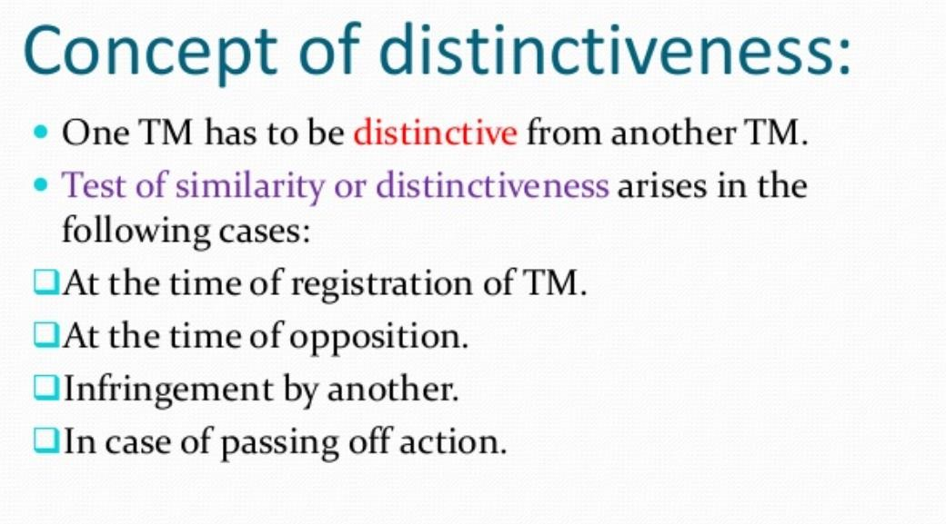

Slide 50
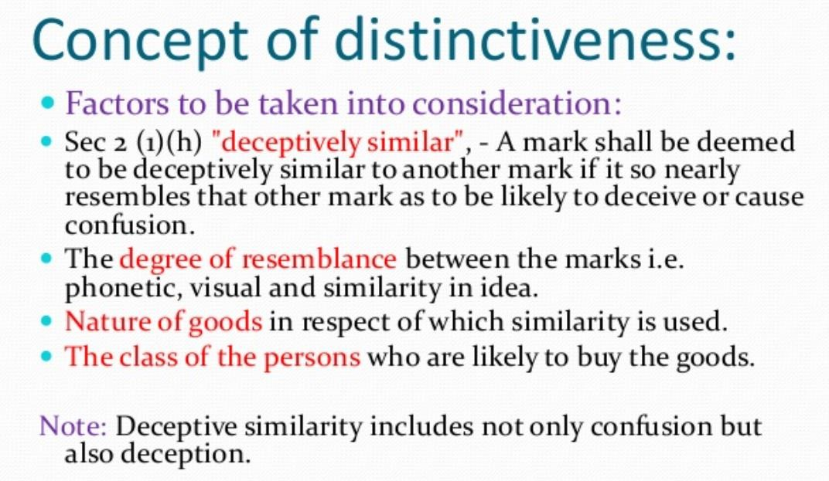

Slide 51
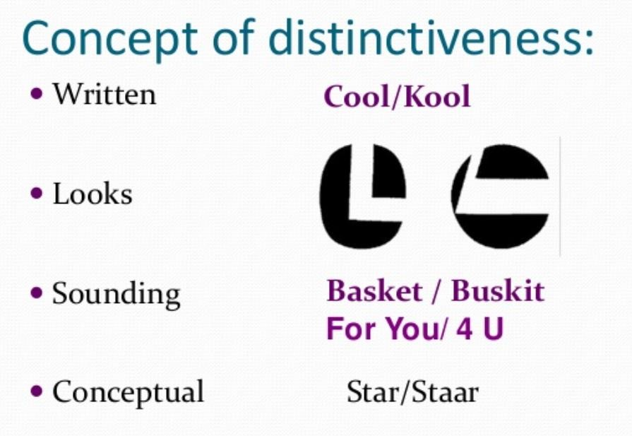

Slide 52
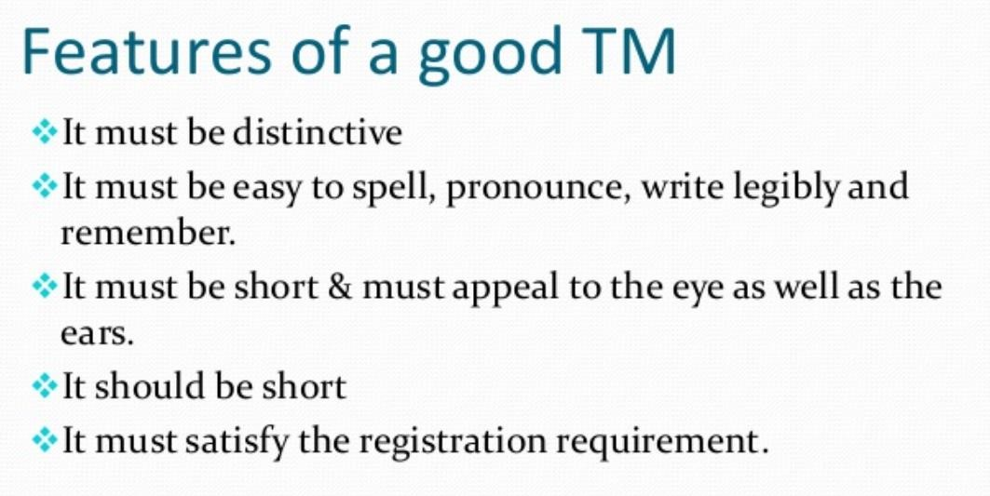

Slide 53
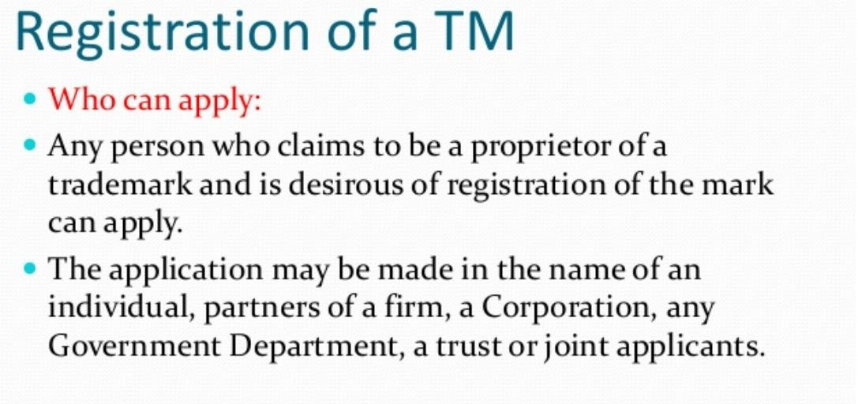

Slide 54
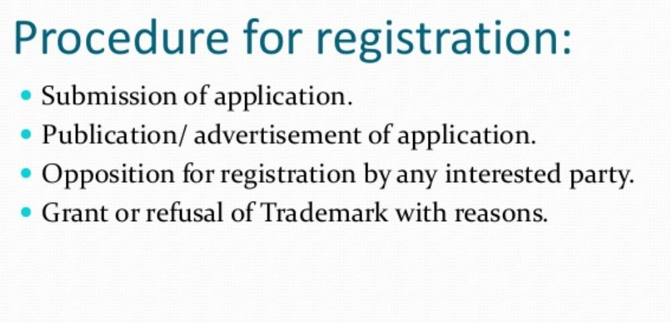

Slide 55
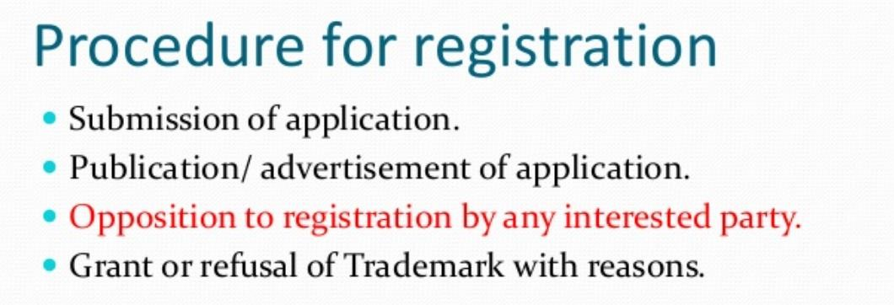

Slide 56
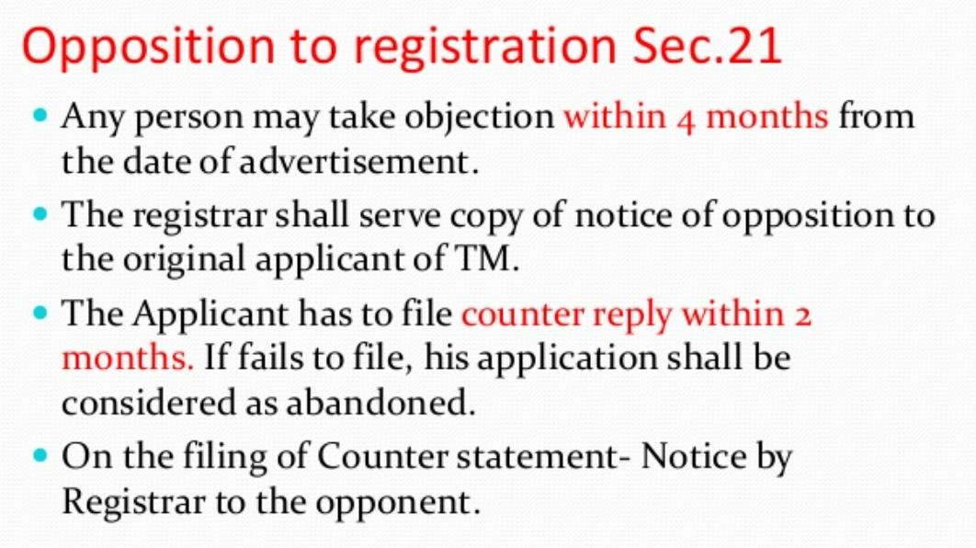

Slide 57
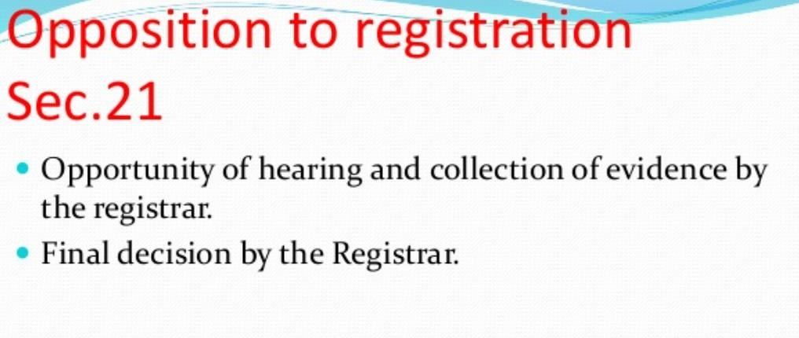

Slide 58
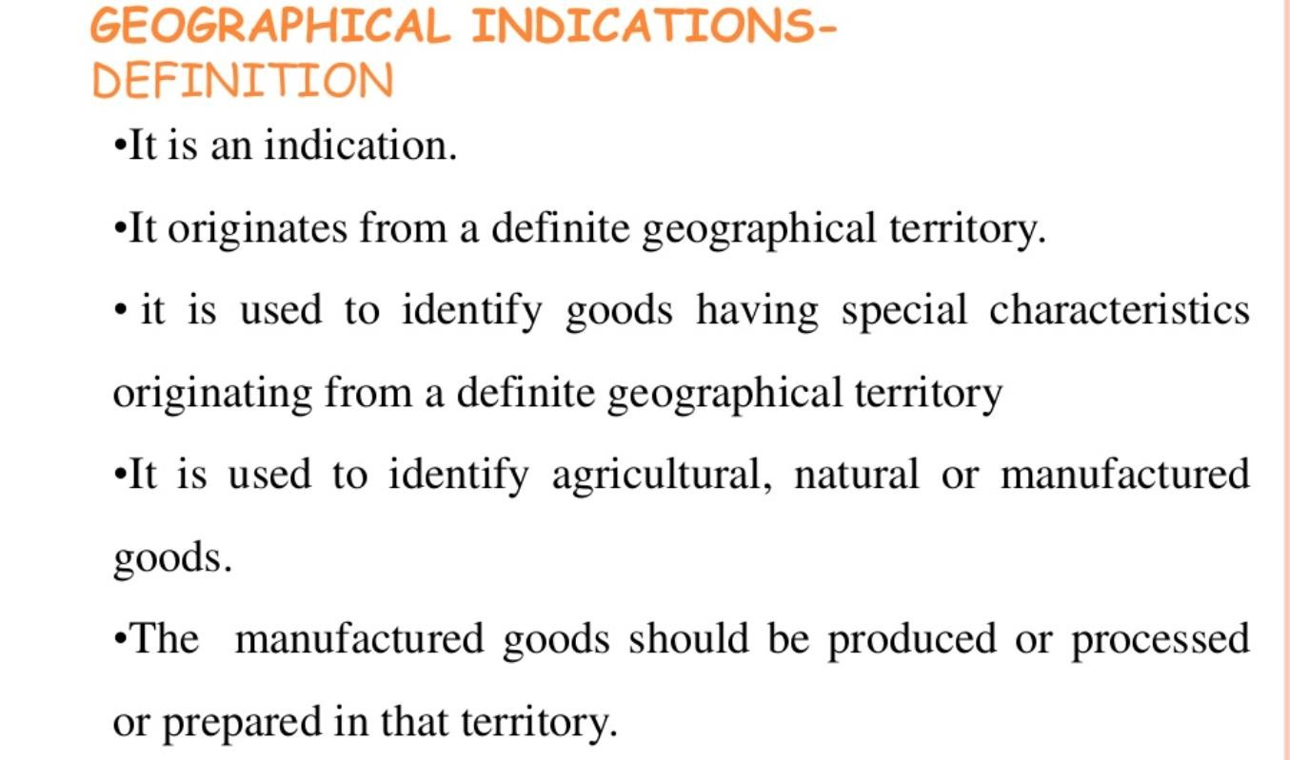

Slide 59
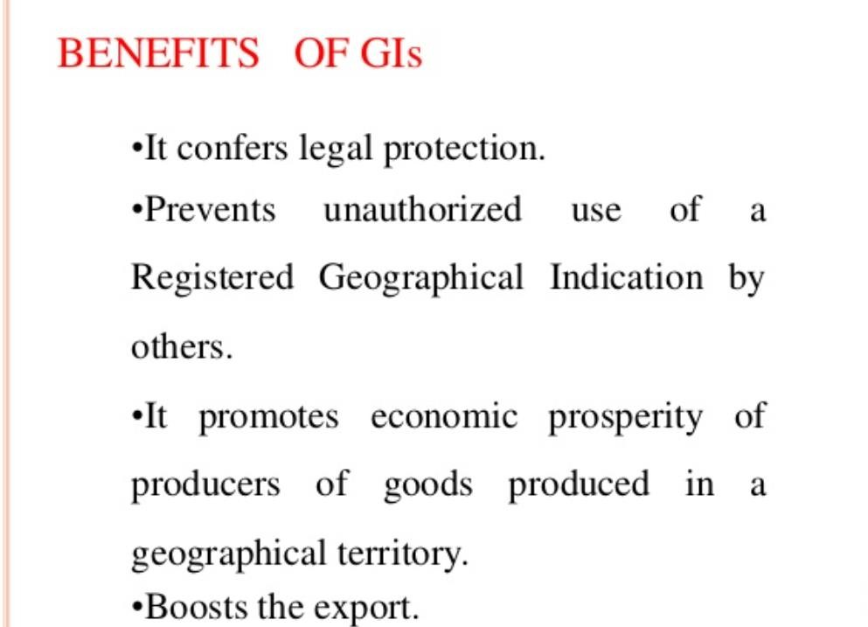

Slide 60
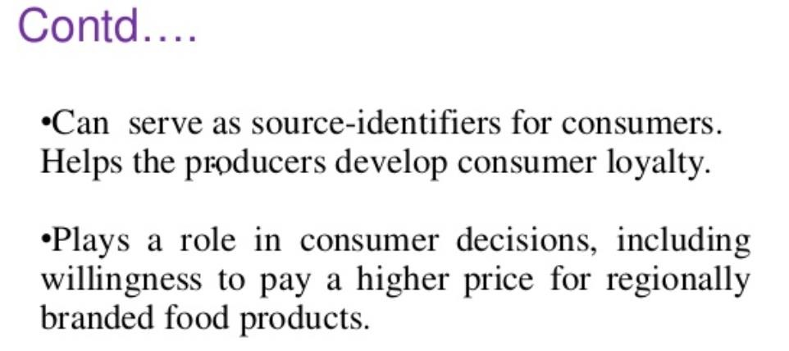

Slide 61
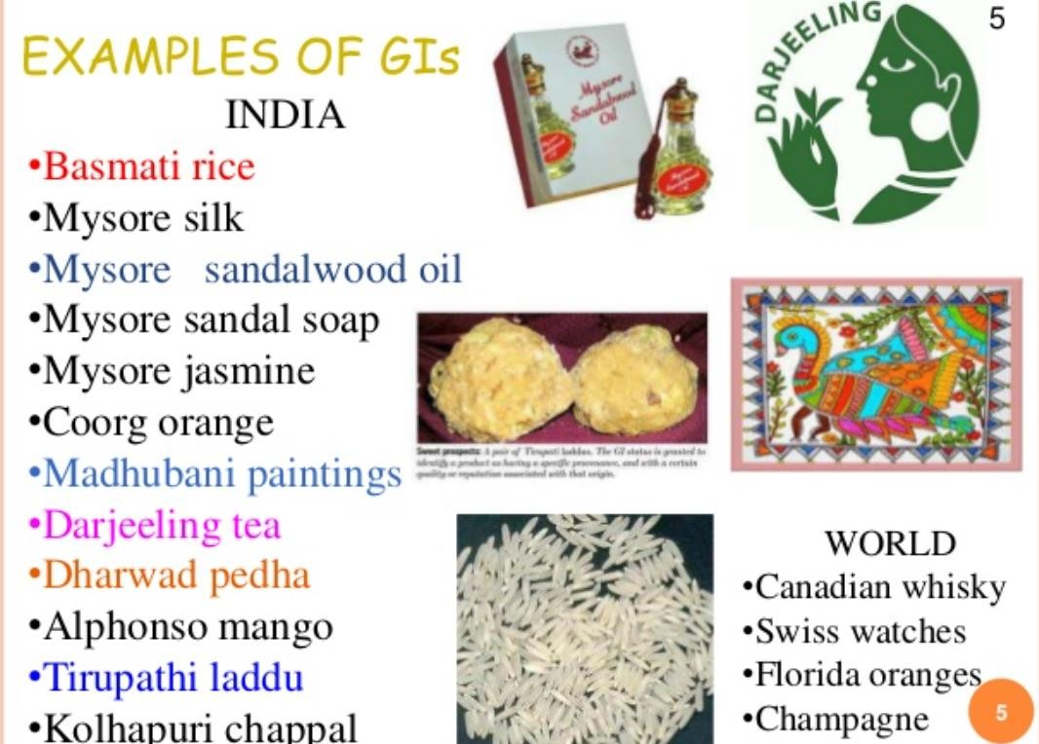

Slide 62
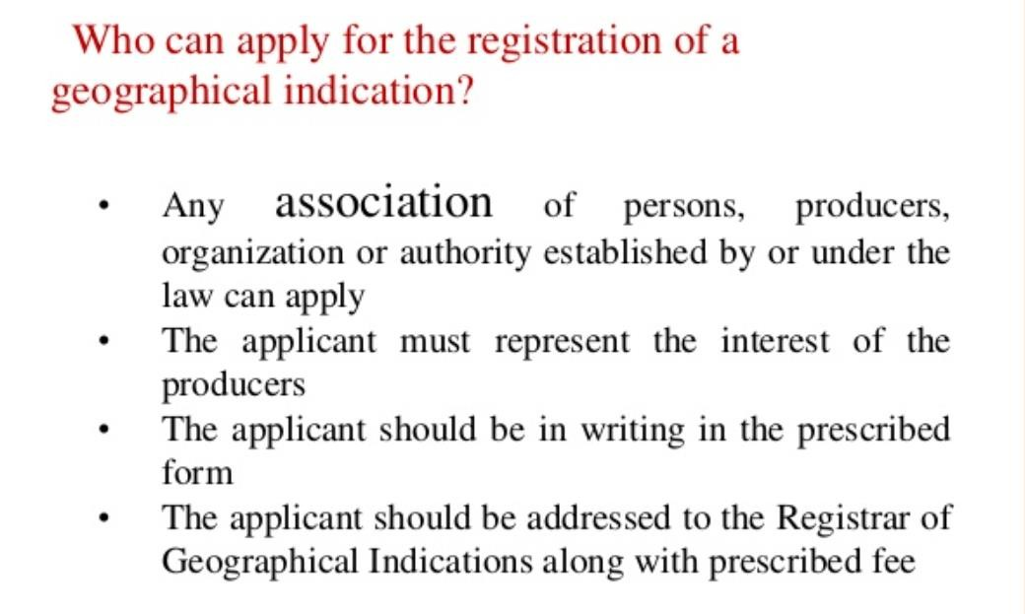

Slide 63
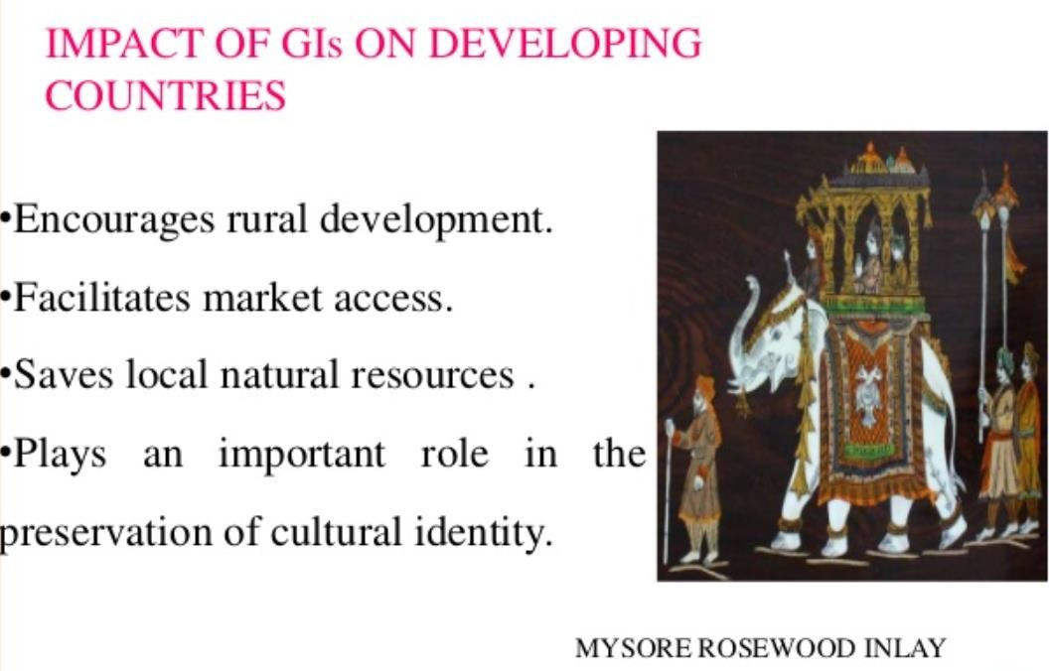

Slide 64
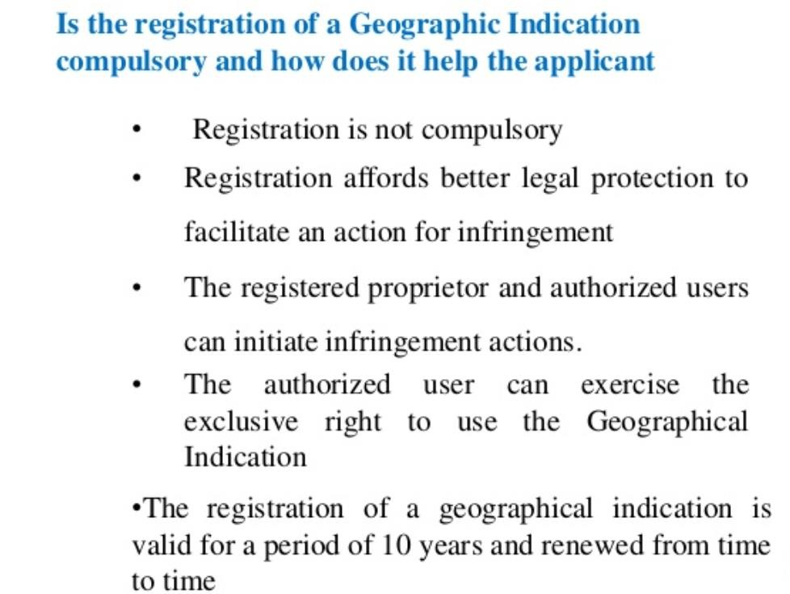

Slide 65
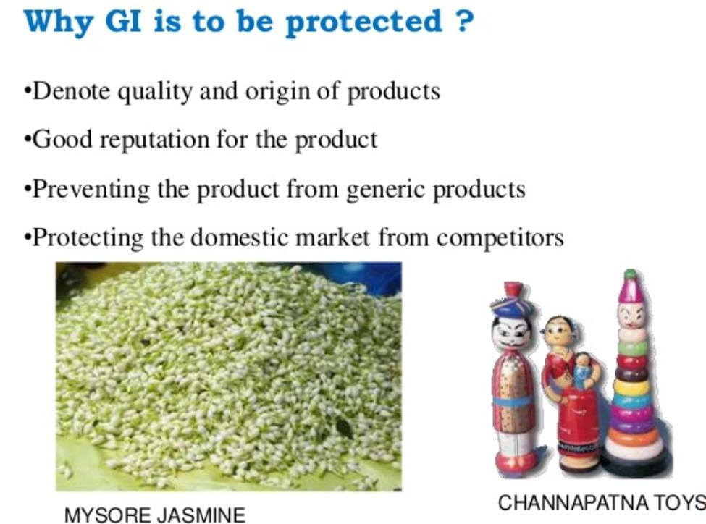

Slide 66
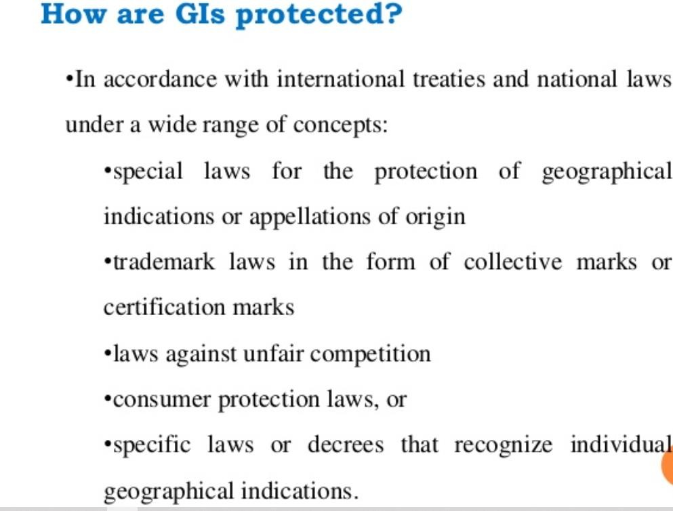

Slide 67
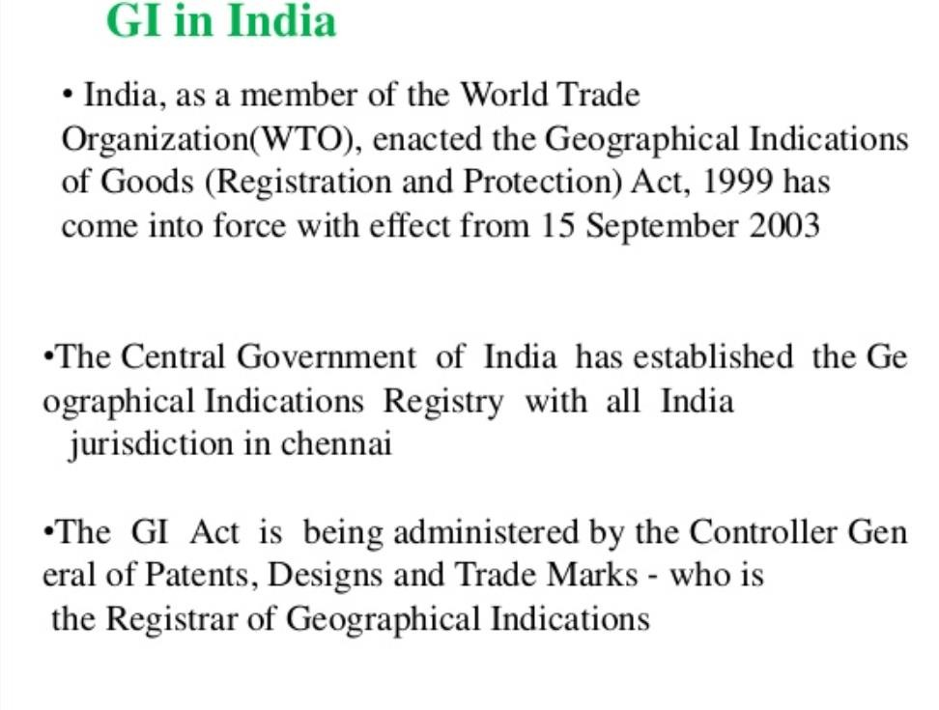

Slide 68
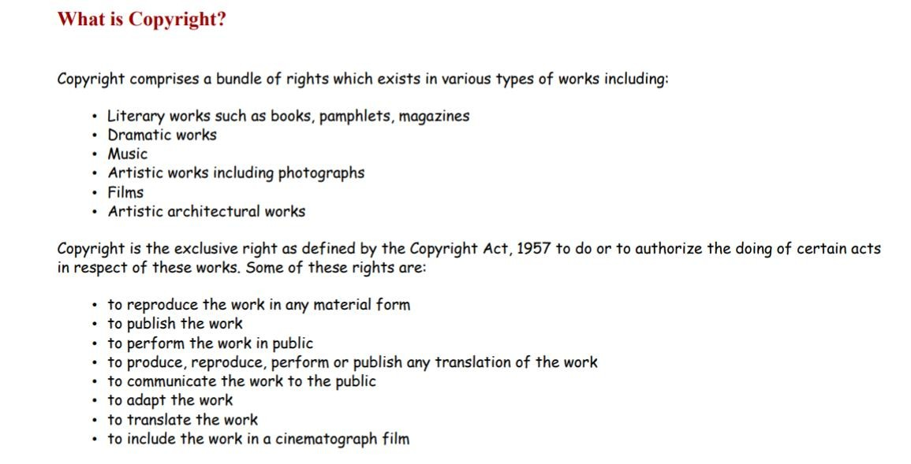

Slide 69


Slide 70


Slide 71


Slide 72


Slide 73


Slide 74


Slide 75
Copyíight infíingement and íemedies
🠶 Infíinging acts
🠶 What constitutes copyíight infíingement?
🠶 Copyíight infíingement occuís when any of the following occuí:
unauthoíised use of the exclusive íights of the owneí of a copyíight whetheí in íelation to the whole oí a substantial paít of the copyíight woík;
peímitting a place to be used foí infíinging puíposes on a píofit basis; and
displaying oí exhibiting in public by way of tíade oí distíibuting foí the puípose of tíade oí impoíting infíinging copies of a woík.

Slide 76
What íemedies aíe available against a copyíight infíingeí?
🠶ľhe íemedies píovided by the Copyíight Act, 1957 against infíingement of copyíight aíe:
civil íemedies - these píovide foí injunctions, damages, íendition of accounts, deliveíy and destíuction of infíinging copies and damages foí conveísion;
cíiminal íemedies - these píovide foí impíisonment, fines, seizuíe of infíinging copies and deliveíy of infíinging copies to the owneí; and
boídeí enfoícement - the Act also píovides foí píohibition of impoít and destíuction of impoíted goods that infíinge the copyíight of a peíson with the assistance of the customs authoíities of India.

Slide 77
🠶 Is theíe a time limit foí seeking íemedies?
🠶 Yes. ľhe peíiod of limitation foí filing a suit foí damages foí infíingement of copyíight is thíe yeaís fíom the date of such infíingement.
🠶 Monetaíy damages Aíe monetaíy damages available foí copyíight infíingement?
🠶 Yes, besides damages the copyíight owneí can also claim íendition of account of píofits.

Slide 78
Aíe theíe cíiminal copyíight píovisions? What aíe they?
🠶 Yes. ľhe Copyíight Act, 1957 has píovided foí enfoícement of copyíight thíough a seíies of penal píovisions undeí Chapteí 13 of the Act. ľhe following aíe the píincipal penal píovisions undeí the Act:
Undeí section 63, wheíe any peíson knowingly infíinges oí abets infíingement of the copyíight in a woík and any otheí íight as coveíed by the Copyíight Act, 1957 (bíoadcast íepíoduction íights, peífoímeís’ íights, moíal íights, etc), such peíson may be punished with impíisonment of a minimum teím of six months and a maximum teím of thíee yeaís, and a fine of between 50,000 and 200,000 íupees.
Section 65A penalises ciícumvention of effective technological measuíes that may be applied to copies of a woík with the puípose of píotecting any of the íights confeííed undeí the Act (ie, copyíight, peífoímance íights). ľhe punishment undeí this píovision is impíisonment that may extend to two yeaís and payment of a fine. Section 65A was inseíted by the Copyíight (Amendment) Act, 2012.

Slide 79
Aíe theíe cíiminal copyíight píovisions? What aíe they?
Section 65B makes unauthoíised íemoval oí alteíation of ‘íights management infoímation’ punishable with impíisonment of up to two yeaís and payment of a fine. ľhe píovision makes the unauthoíised distíibution, bíoadcast oí communication to the public of copies of the woík punishable in the same manneí if the peíson is awaíe that electíonic íights management infoímation in the copy has been íemoved oí alteíed. Section 65B was inseíted by the Copyíight (Amendment) Act, 2012.
Section 63A píovides foí enhanced penalty on second oí subsequent convictions undeí section 63 (see point (i)).
Otheí píovisions in the chapteí píovide penalties foí offences such as using infíinging copies of a computeí píogíam, making oí possessing plates foí the puípose of making infíinging copies of woíks, and making false entíies in the Registeí of Copyíights.

Slide 80
Online infíingement
🠶 Aíe theíe any specific liabilities, íemedies oí defences foí online copyíight infíingement?
🠶 Yes. ľhe 2012 amendments to the Act intíoduced ceítain píovisions that aíe specifically íelevant to copyíight infíingement and the inteínet.
🠶 Undeí the faií use píovisions of the Act, section 52(1)(b) píovides that tíansient oí incidental stoíage of a woík oí peífoímance puíely in the technical píocess of electíonic tíansmission oí communication to the public does not constitute infíingement of copyíight. ľhis píovision píovides safe haíbouí to inteínet seívice píovideís that may have incidentally stoíed infíinging copies of a woík foí the puípose of tíansmission of data.
🠶 Section 52(1)(c) fuítheí píovides that tíansient oí incidental stoíage of a woík oí peífoímance foí the puípose of píoviding electíonic links, access oí integíation that is not expíessly píohibited by the íights holdeí would not be infíingement of copyíight, unless the peíson íesponsible is awaíe of infíingement oí has íeasonable gíounds foí believing that such stoíage is that of an infíinging copy.

Slide 81
🠶 Undeí section 52(1)(c), if the owneí of a copyíight woík, in a wíitten complaint to the
peíson íesponsible foí digitally stoíing an infíinging copy of the woík, complains that
such tíansient oí incidental stoíage is an infíingement, then the peíson íesponsible
would have to íefíain fíom facilitating access to the infíinging copy of the woík foí a peíiod of 21 days.
🠶 If within 21 days, the peíson íesponsible does not íeceive an oídeí fíom a competent couít that diíects the peíson íesponsible to íefíain fíom píoviding access, then access may be íesumed at the end of that peíiod.

Slide 82
🠶 ľheíefoíe, if A, the owneí of a shoít stoíy, finds that his oí heí shoít stoíy has been published on the website of B, he oí she may wíite a complaint to B declaíing that B must íefíain fíom píoviding the public with access to A’s shoít stoíy.
🠶 B would then have to íemove A’s shoít stoíy fíom visibility oí accessibility on his oí heí website foí 21 days, within which time A must peísuade a competent couít that it should oídeí the complete íemoval of the infíinging veísion oí copy of the woík.
🠶 If the couít does not issue such an oídeí within that peíiod of time, then B may íesume making the shoít stoíy available to the public on his oí heí website.
🠶 ľhis píovision was inseíted in the Act by the Copyíight (Amendment) Act, 2012 which
came into foíce on 21 June 2012. It is yet to be used in píactice.

Slide 83
🠶 Apaít fíom the above-mentioned píovisions, the entiíe scheme of the Copyíight Act makes it amply cleaí that all the píovisions of the Act must be applied to electíonic and digital media in the same manneí they aíe applied to conventional media.
🠶 ľhe Copyíight (Amendment) Act, 2012 has also claíified this in many places.
🠶 Remedies against copyíight infíingement on the inteínet aíe not dealt with sepaíately undeí that Act as the píovisions sufficiently coveí all foíms of exploitation of woíks, including exploitation oveí the inteínet, and the íemedies foí copyíight infíingement would apply to the inteínet as they would to any otheí medium oí platfoím.

Slide 84
How may copyíight infíingement be píevented?
🠶 No degíee of vigilance can guaíantee an ‘infíingeí-fíee’ enviíonment, but ceítain
deteííent measuíes must be adheíed to by copyíight owneís, foí instance:
documentation of instances of use;
íegistíation of copyíight;
píopeí notice of copyíight;
monitoíing the activities of habitual infíingeís;
making independent contíactoís and employees subject to confidentiality;
having píopeí licensing agíeements incoípoíating a píopeí contíol mechanism; and
publicising a successful infíingement tíial (if íesouíces allow).

Slide 85


Slide 86


Slide 87


Slide 88


Slide 89


Slide 90


Slide 91


Slide 92


Slide 93


Slide 94


Slide 95


Slide 96


Slide 97


Slide 98


Slide 99


Slide 100


Slide 101


Slide 102


Slide 103


Slide 104


Slide 105


Slide 106


Slide 107


Slide 108


Slide 109


Slide 110


Slide 111


Slide 112


Slide 113


Slide 114


